Slide 1



“Cybersecurity Breach Analysis Dashboard” - Interactive Data Storytelling Using Power BI and CRISP-DM Framework
REVA Academy for Corporate Excellence (RACE)
A biometric authentication system that maps facial features to unlock devices.
Importance
Security: Protects sensitive data.
Convenience: Quick and hands-free.
By: Sonika R M. Tech in AI (FT Batch 3)
Objective of the presentation
Analyze the technical process, challenges, benefits, and design considerations of face recognition unlocking.
Use the Six Thinking Hats methodology for holistic insights.
29th April 2025
Under the guidance of :
Dr. Shinu Abhi
Professor and Director,
RACE, REVA University
www.race.reva.edu.in

Slide 2
CONTENTS
01 Introduction
06 Data Modelling
02
CRISP-DM Framework Overview
07
08
DAX Measures and Calculations
03
Business Understanding
Dashboard Design and Pages
04
Data Understanding
09
Key Insights and Analysis
05 Data Preparation
10
Conclusion

Slide 3
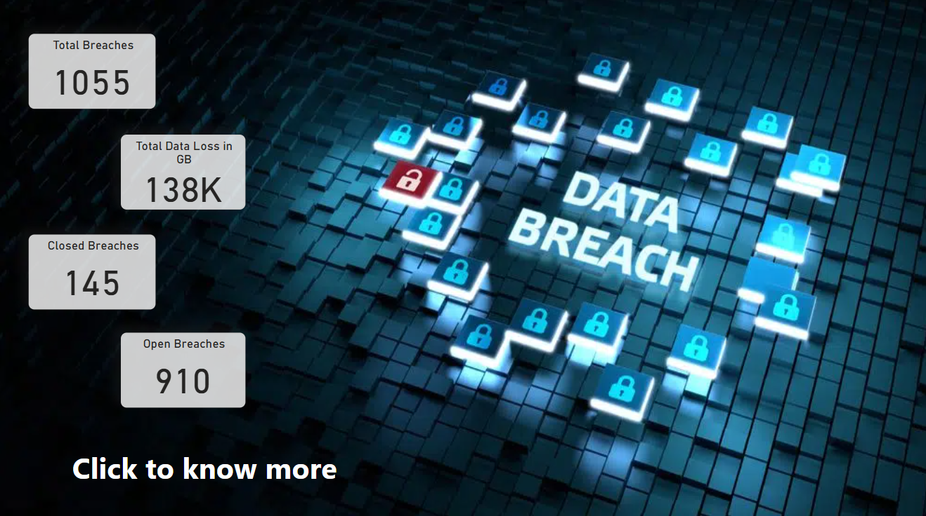
Introduction
Analyze cybersecurity breaches to uncover patterns, identify risk areas, and improve breach mitigation using Power BI.

Slide 4
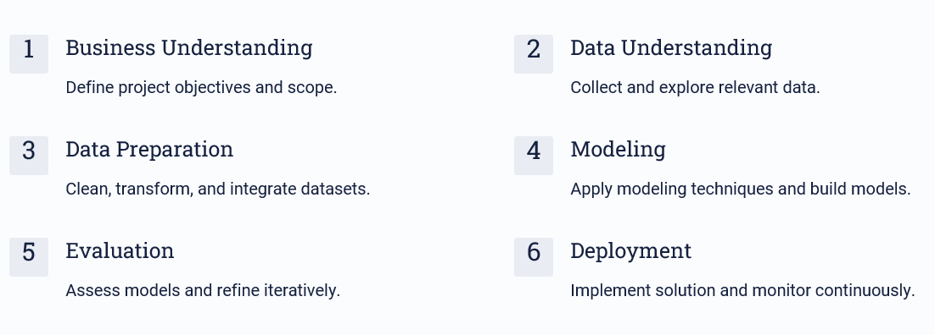
CRISP-DM Framework Overview
CRISP-DM (Cross-Industry Standard Process for Data Mining) guides the structured development of this data storytelling project.

Slide 5
Business Understanding
Objective:
The primary objective was to analyze cybersecurity breaches to uncover patterns, track breach status (open/closed), measure breach duration, assess employee involvement, and estimate data loss. This enables organizations to proactively understand vulnerabilities and improve breach mitigation strategies.
Key questions addressed:
What types of breaches are most common?”
Which departments and branches are most affected?
How do employees contribute to breach detection?
How severe are breaches in terms of duration and data loss?

Slide 6
Data Understanding
Exploratory analysis of the Cybersecurity Breach dataset was conducted.
Key Observations:
Dataset contained columns such as Breach Type, Affected Individuals, Estimated Data Stolen, Breach Dates, Branch, Department, and Employee Details.
Identified missing values in breach_end and business associate fields.
Observed inconsistency in naming and datatype mismatches (e.g., dates stored as text).
Realized that multiple Branches, Departments, and Employees existed without unique identifiers, impacting star schema design.

Slide 7
Data Preparation
Extensive data cleaning was performed using Power Query:
Renamed inconsistent columns for clarity (e.g., 'Total Indicviduals' → 'Total_Individuals').
Converted breach_start and breach_end to proper datetime format.
Created calculated columns:
Breach_Status (Open/Closed based on breach_end)
Breach_Duration_Days (Date difference)
Data_Loss_Per_Individual_MB
Is_Associate_Involved
Created dimension tables (Branch, Department, Country, Employee) by referencing main table and removing duplicates."

Slide 8
Data Modeling
A relational star schema was built:
Central Fact Table: Cleaned_Cyber_Security_Breaches
Dimension Tables: Branch, Department, Country, Employee
Established one-to-many relationships.
Ensured dimension tables contained only unique records.
Enabled easy filtering and drill-down capabilities in the dashboard.

Slide 9
Modeling (continued) - DAX Measures
Developed important DAX Measures:
Total Breaches
Open Breaches and Closed Breaches
Total Data Loss (GB)
Average Breach Duration (Days)
Employee Breach Detection Rank (RANKX function)

Slide 10
Evaluation
Analyzed the effectiveness of the dashboard by validating results across different filters:
Breach types distribution revealed most common threats.
Top-performing employees were identified using rankings.
Departments and branches with highest risk were highlighted.
Duration analysis helped spot delayed breach closures. The model successfully answered the business questions posed.

Slide 11
Conclusion
Through the application of the CRISP-DM methodology, a comprehensive cybersecurity breach analysis dashboard was developed using Power BI.
Key Achievements:
Cleaned and structured complex breach data for reliable insights.
Designed a star schema model ensuring scalability and performance.
Built dynamic DAX measures to enable real-time analysis and interactivity.
Delivered multi-page dashboards providing critical views across employees, departments, branches, and breach types.

